Slide 1


Extending the Allotrope Foundation Ontology: An Ontological Representation and Analysis of
Process Chemistry
Oliver He, Wes Schafer

Slide 2
Outline
Acknowledgements
The Importance of Context
The Scope of Process Chemistry
Survey of Existing Ontologies and Terminologies
Proposal for Process Chemistry Ontology
OPC development strategy and methodology
Upper level hierarchy and design patterns
2 Use Cases
Fate and purge
DoE: Design of Experiment
Example OWL Definitions
Summary & Discussion

Slide 3
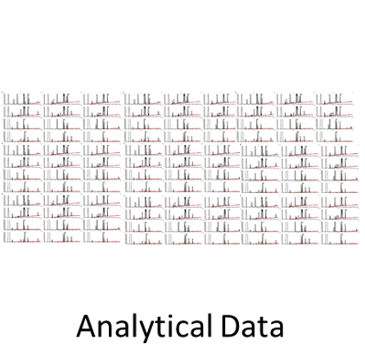
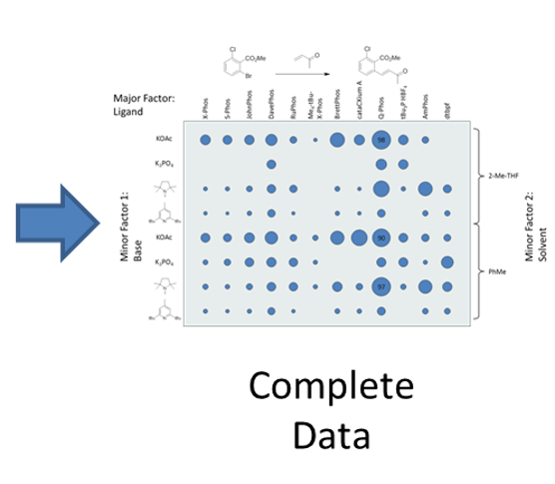
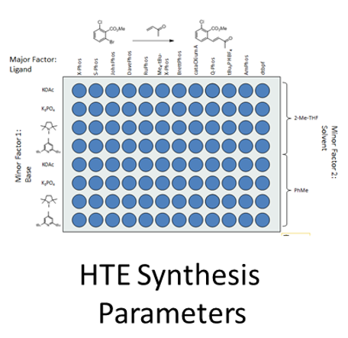

The Importance of Context
e.g., mining analytical parameters as a function of synthesis parameters across experiments
e.g., mining synthesis parameters across experiments
e.g., mining analytical parameters across experiments
Experimental and workflow details need to be linked to the analytical data in order for it to have context and to enable data mining.
We need the language to do this.

Slide 4
Ontology Terms Provide Entry-level Standardization
Implementable for systems not semantically enabled.
Provides standardized data labels
Still provides link to enduring definitions and machine-readable semantics
System 2
Batch
001J013
001J014
System 2
batch identifier
001J013
001J014
System 1
Lot
001J013
001J014
System 1
batch identifier
001J013
001J014
preferred label "batch identifier"
definition "The batch identifier is measurement metadata that identifies the batch where a sample is taken from for being measured. [Allotrope]“
Semantic Definition (machine readable)
Subclass of identifier
and 'measurement metadata'
and (identifies some entity ('has role' some 'batch role'))
Public reference:
http://purl.allotrope.org/ontologies/result#AFR_0001120
System 3
Lot ID
001J013
001J014
System 3
batch identifier
001J013
001J014

Slide 5
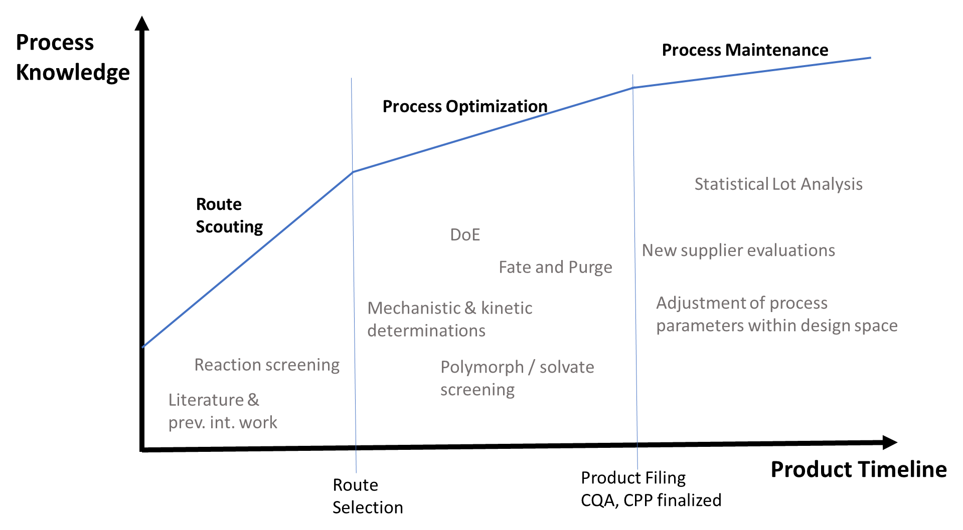
Process Chemistry Lifecycle

Slide 6
Survey of BFO (OBO) Ontologies for Process Chemistry Terms
Domain | Ontology | Application to process chemistry
Top level ontology | BFO (Basic Formal Ontology) | Aligns other ontologies together
Relations | Relation Ontology (RO) | Provides standard commonly used relations
Information | Information Artifact Ontology (IAO) | Provides general information-related terms
Lab measurements | OBI (Ontology for Biomedical Investigations) | Describe laboratory values related to patient diagnostics
Chemical compounds | ChEBI (Chemical Entities of Biological Interest) | Describe metabolites and other chemical entities
Chemical methods | CHMO | https://www.ebi.ac.uk/ols/ontologies/chmo
Organic reactions | RXNO | Name reactions in chemical processes
Units | UO | Units used in chemical processes
Drugs | DrON (Drug Ontology) | Describe patient medications
Proteins (e.g., enzymes) | PRO (Protein Ontology) | Describe protein-related entities and the relations between these entities
No full BFO ontology for the domain of process chemistry exists.

Slide 7
Survey of Vocabularies in Process Chemistry
Two Process Chemistry Vocabularies
Pistoia (formally Elsevier) Unified Data Model (UDM) - Storage and exchange of experimental information about compound synthesis and testing.
ISA-88: a standard that addresses batch process control (https://en.wikipedia.org/wiki/ISA-88)
Several ontology publications in process chemistry
E.g., overview of chemical ontologies: https://arxiv.org/abs/2002.03842
Overall, good introduction and suggestions, but no solid development.
Allotrope Foundation Ontologies (AFO):
AFO covers some results pertinent to process Chemistry (http://docs.allotrope.org/).
AFO/AFM covers derivatization which parallels organic synthesis.
Our thorough survey found no complete ontology(ies) that focus on the domain of process chemistry, a major branch of pharmaceutical chemistry.

Slide 8
Proposal of OPC: “Ontology of Process Chemistry”
A new ontology, OPC with the focus on the domain of process chemistry.
OPC covers the entire timeline from route scouting to reaction optimization to process maintenance.
Example components of the proposed OPC:
Reaction kinetics and mechanism (incl stoichiometry)
Polymorphism, solvates
Additional material roles (surfactants, flocculants, etc.)
Key reaction types: additions, eliminations etc. (coverage by REAXNO)
Unit operations such as filtering, refluxing etc.
Filings

Slide 9
OPC development strategy and methodology
eXtensible ontology development (XOD):
Term reuse, alignment, design pattern, and community extensibility
OBO Foundry ontology development principles
Allotrope Foundation Ontology Style Guide
Up-down design:
OPC aligns with the Basic Formal Ontology (BFO).
Bottom-up design:
Common operations, basic reaction pattern (implied by ADM)
Use cases based on workflows (often required by regulatory agencies).

Slide 10
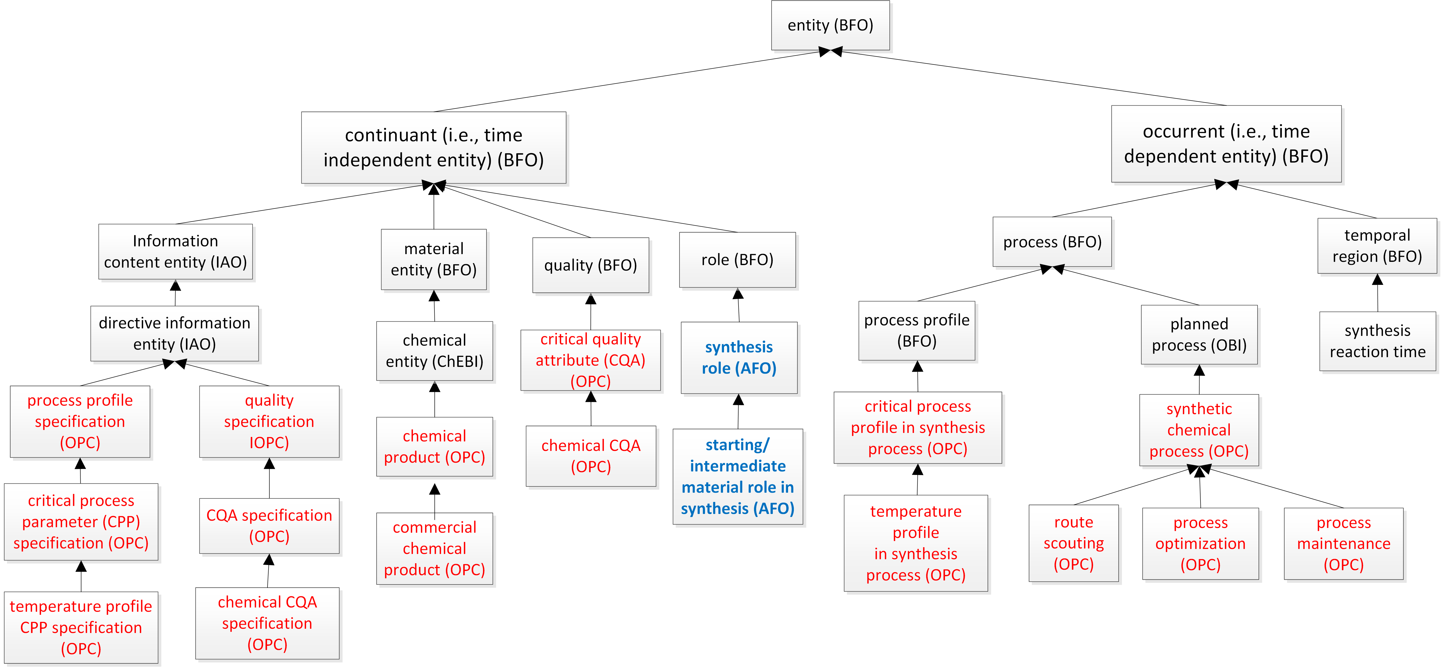
Top-Down: Define Upper level of OPC
Align with BFO

Slide 11
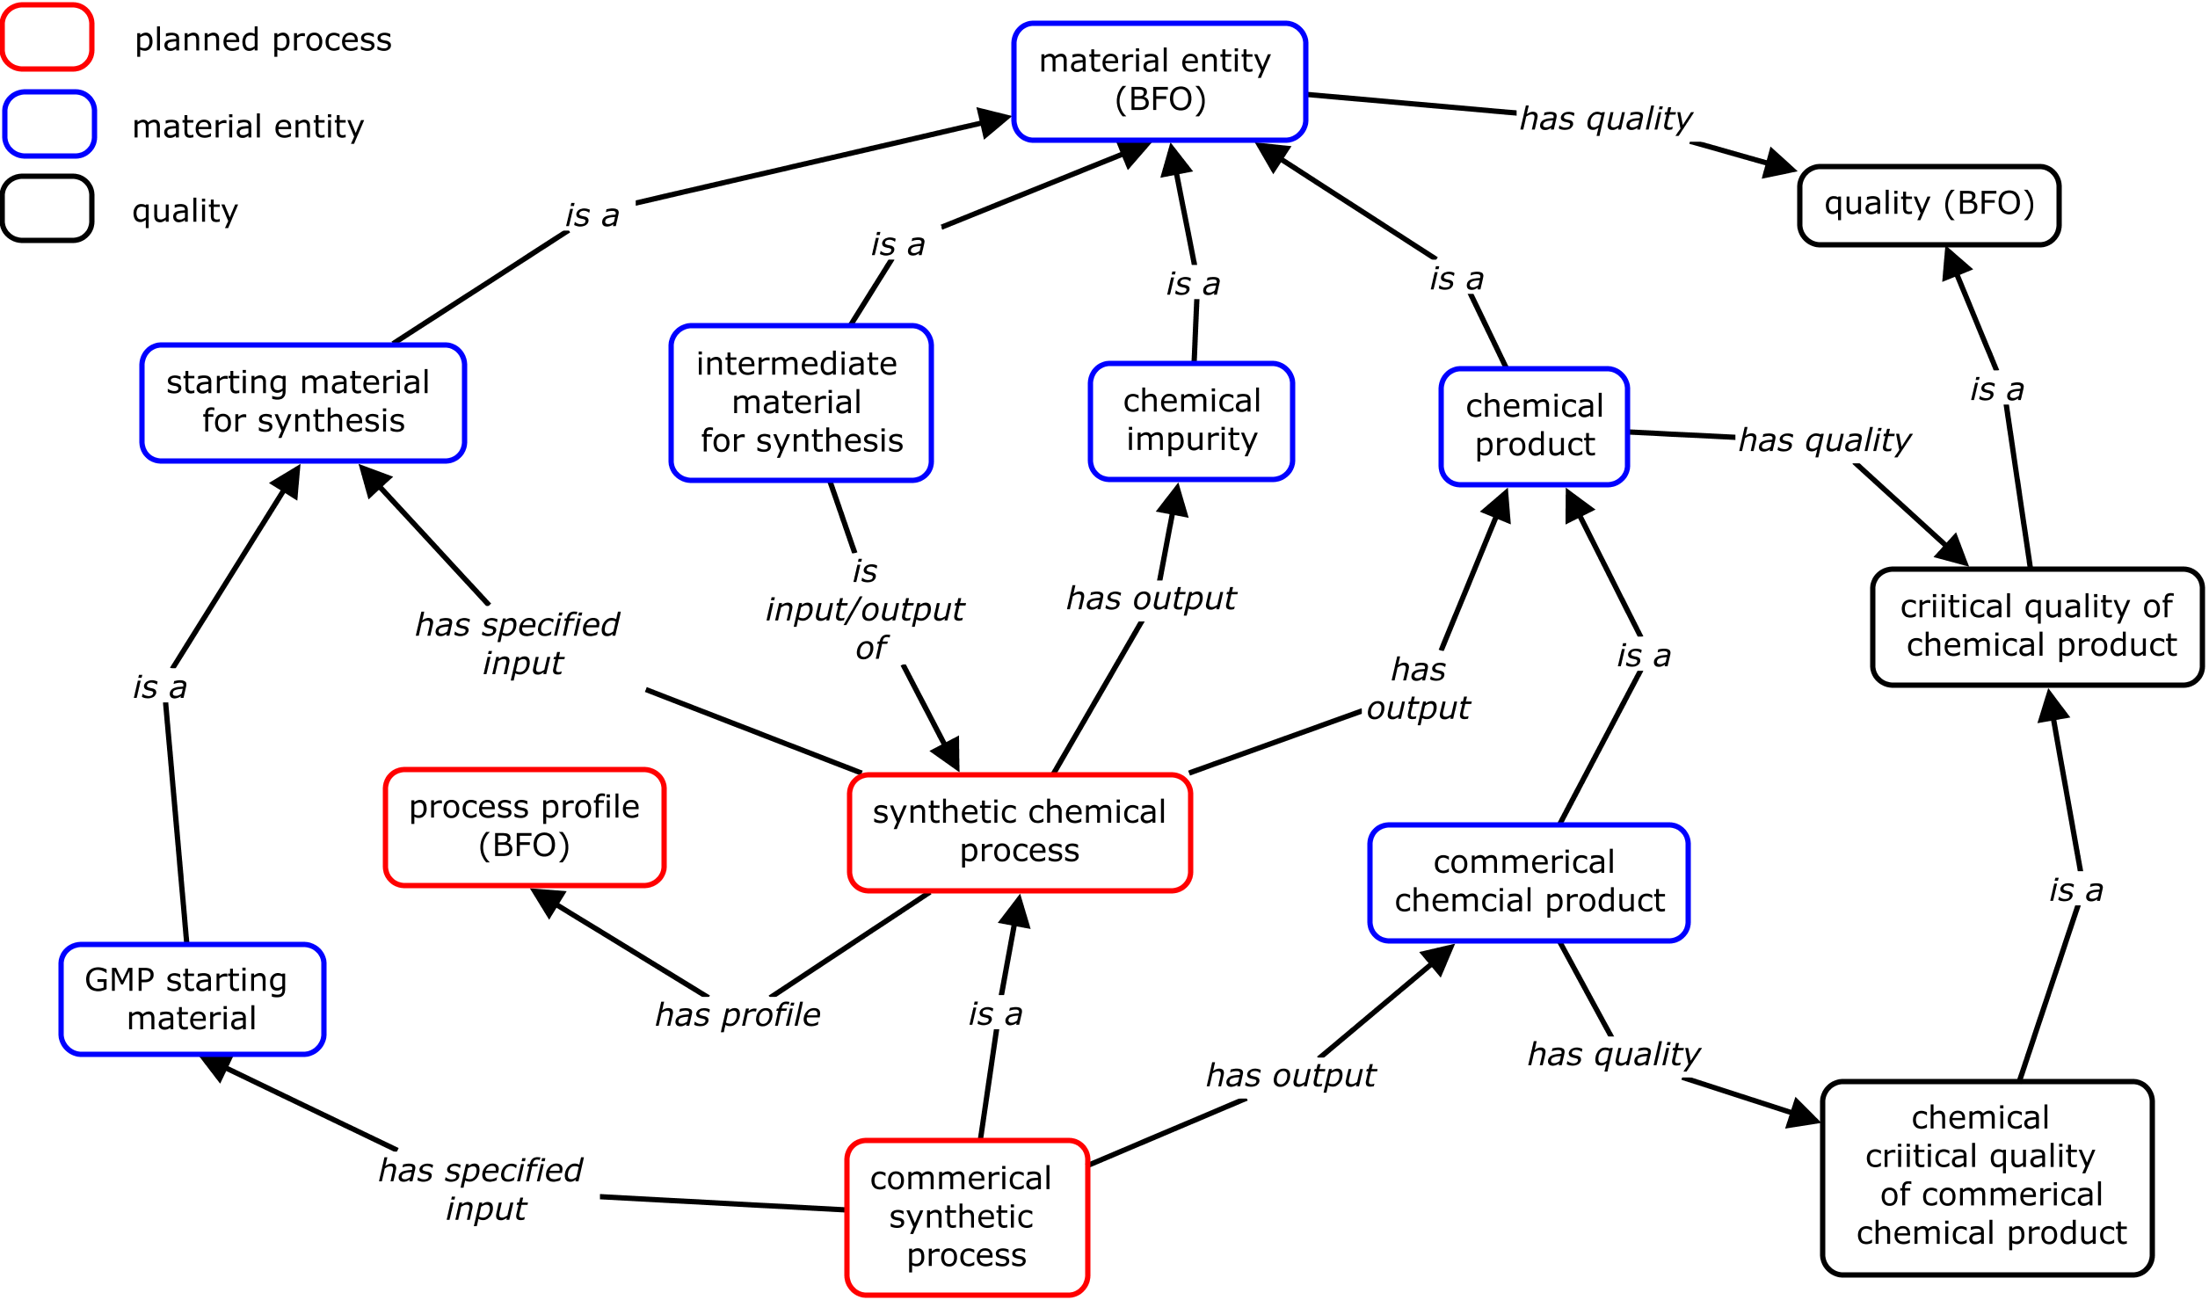
OPC design pattern for a chemical process
BFO compliant, consistent with AFO

Slide 12
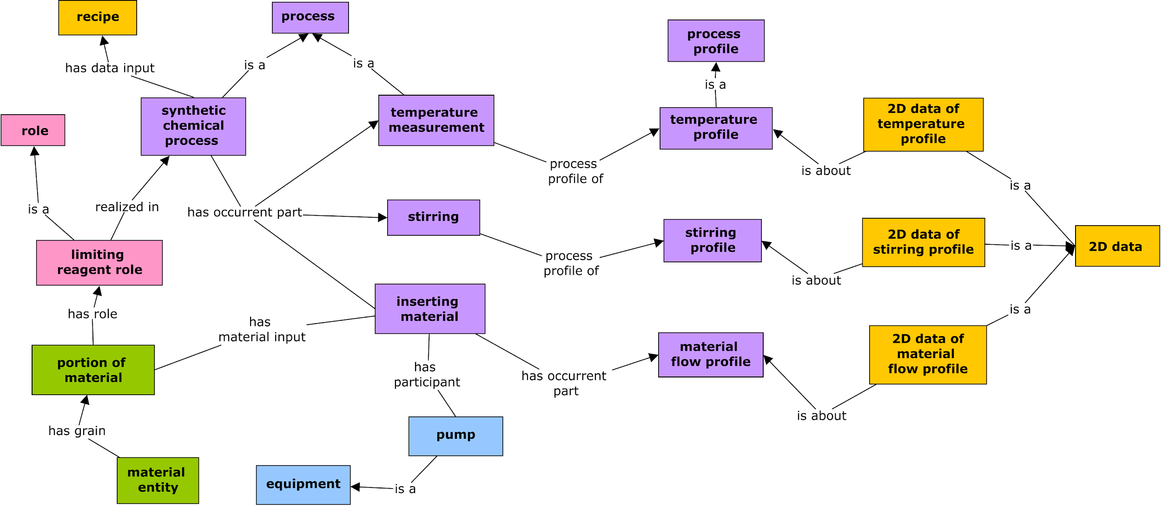
OPC unit operation processes detail syntheses
Leveraging existing vocabularies (ontologies when available)
More unit operations: crystallization, salt formation, pH adjustment, etc.

Slide 13
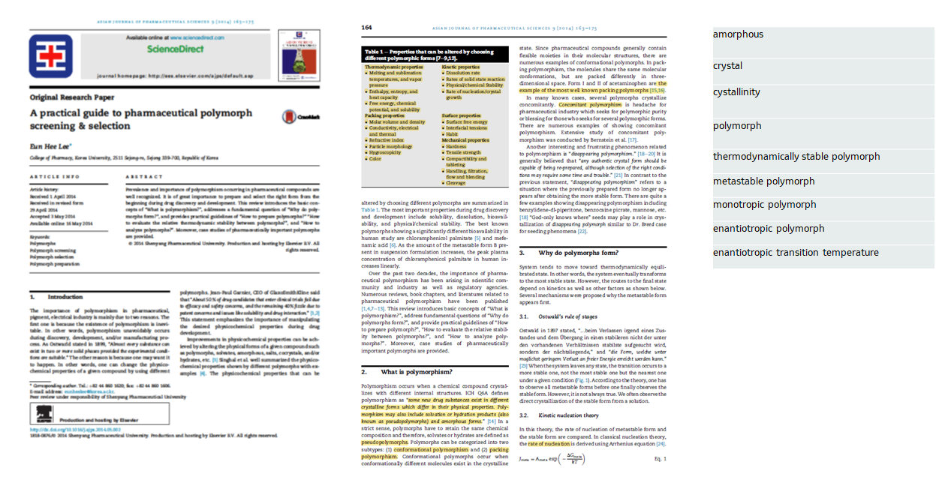
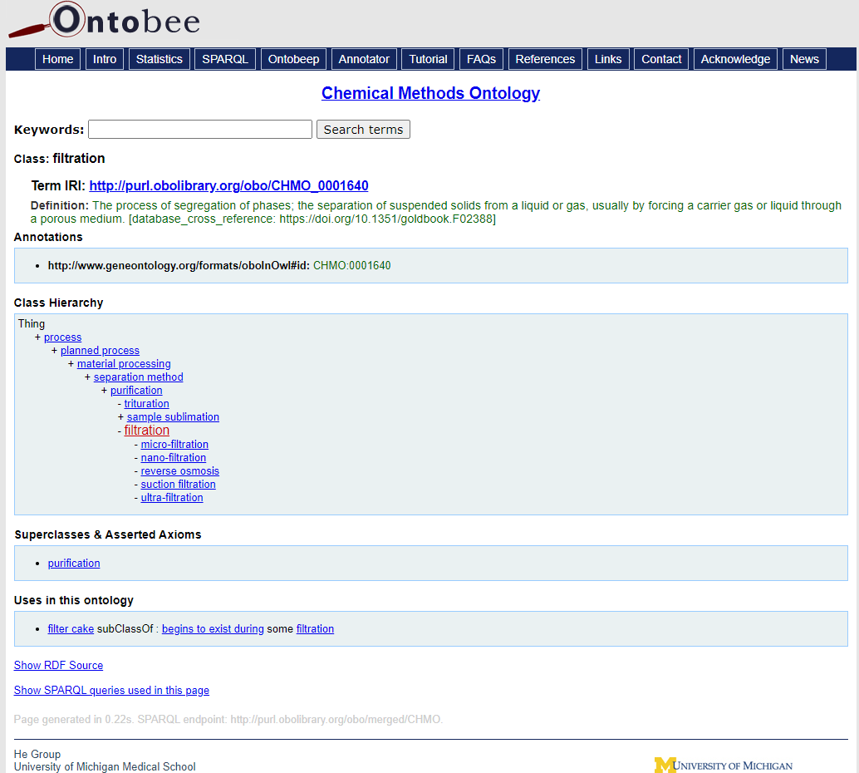
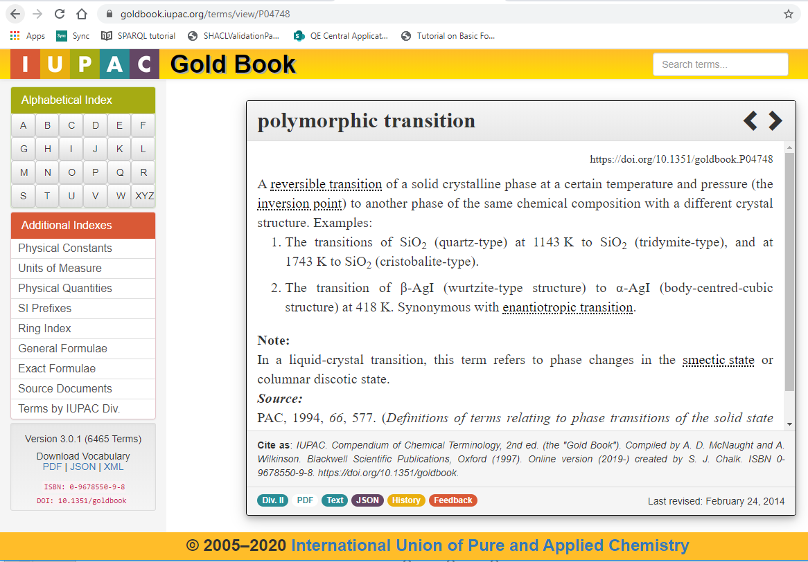
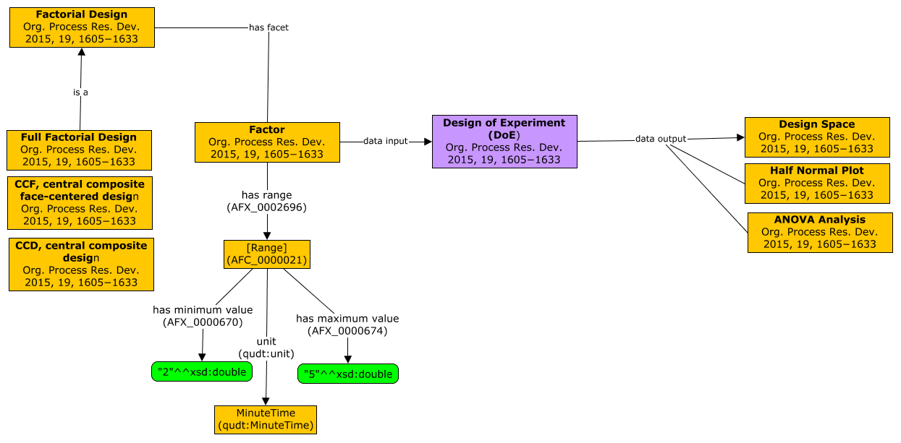
Vetting Workflows - Bottom-Up General Process
Engage SME’s: identify key published material to avoid proprietary issues.
Parse terms from articles (2-4).
Survey existing terms (OBO Foundry, AFO, IUPAC) / identify gaps.
Build “scaffold” CMAP to facilitate ontology development (OWL definitions)

Slide 14
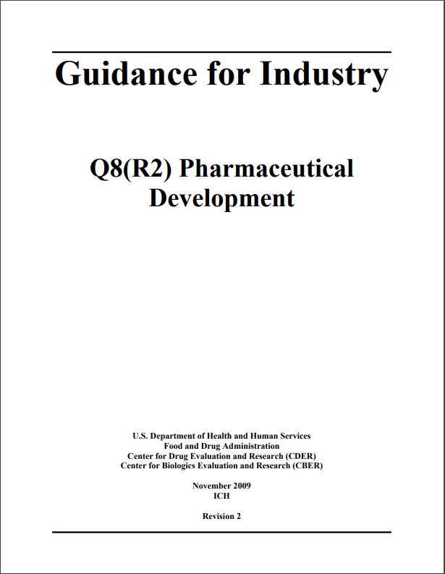
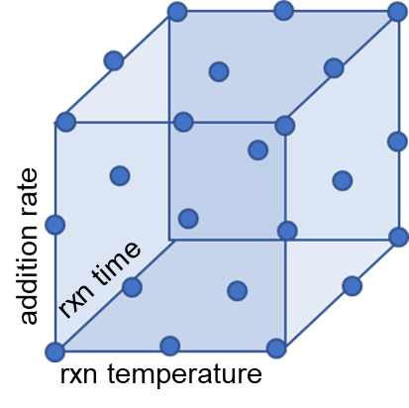
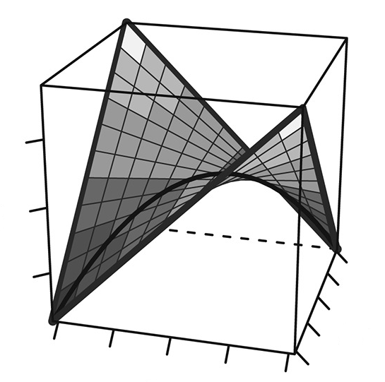
Use Case 1: DoE Studies
“Quality by Design (QbD): A systematic approach to development that begins with predefined objectives and emphasizes product and process understanding and process control, based on sound science and quality risk management.”
e.g. Allotrope PAT and chromatography data models
Factorial Design
Multi-dimensional approach to
understanding key factors / variables and their interdependence
Response Curves
aggregate experimental meta data with analytical (instrument) results to enable decision making (design space).
DoE Study Implementation
Objective Definition
Factor and Range Definition
Response Definition
Experimental Data Collection
Data Analysis
Confirmatory Reactions
Variable interactions can be modeled by graphs
A_{i}i + A_{j1j2}j+ A_{f(k1,k2)}k
area percent -> conversion
rxn time
rxn temperature

Slide 15
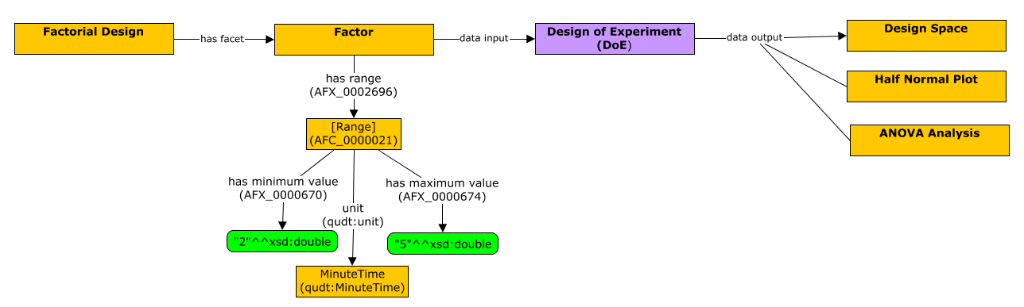
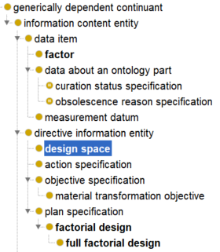
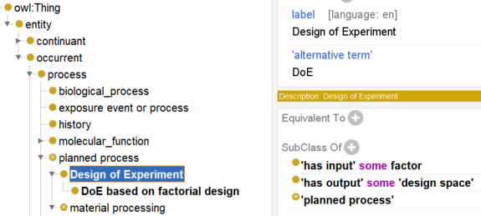
Example terms from Use Case 1: DoE Studies

Slide 16
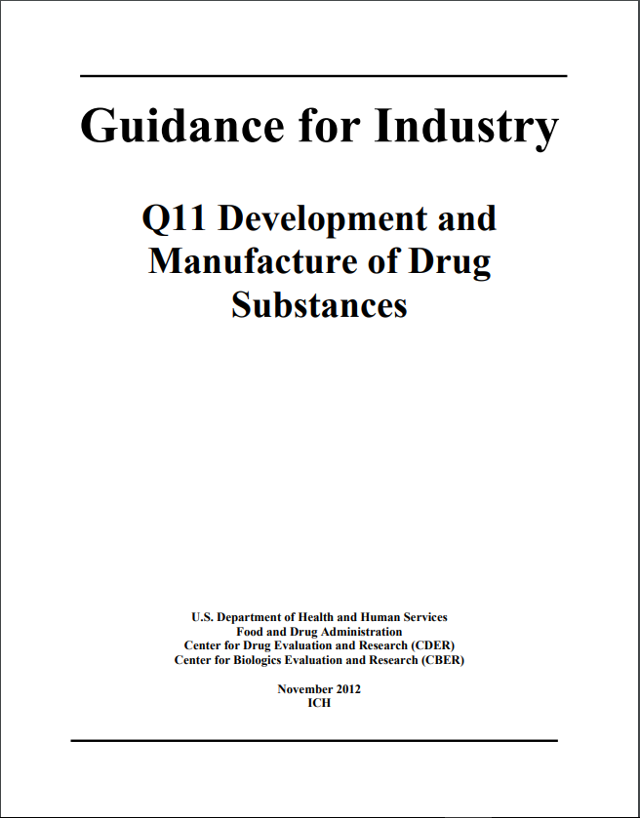
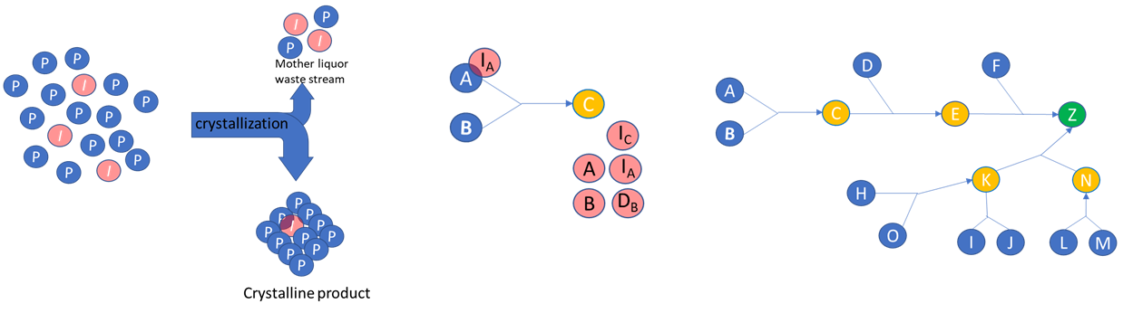
Use Case 2: Fate and Purge Studies
“It is important to understand the formation, fate (whether the impurity reacts and changes its chemical structure), and purge (whether the impurity is removed by, for example, crystallization, extraction), as well as their relationship to the resulting impurities that end up in the drug substance as CQAs”
e.g. Allotrope chromatography and SQD models
Analytical analyses of process streams determines purge factors of individual steps
Aggregation of experimental data tells the whole story of the ultimate fate of impurities and overall purge factors
Impurity Purging by Simple Crystallization Process
Unreacted reagents, reaction by-products
and degradation of impurities complicate fate analyses
Complicated Synthetic Processes push the capabilities of relational models (Graphs are Scalable)

Slide 17
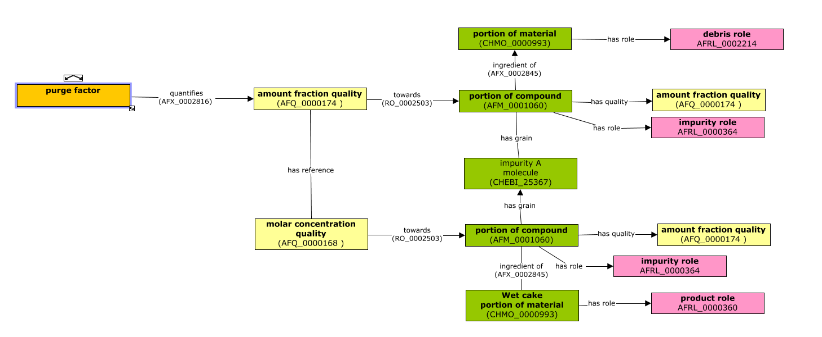
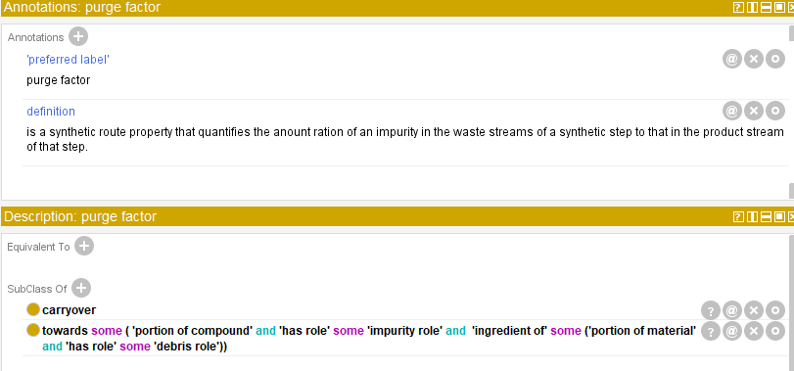

Example terms from Use Case 2: Fate and Purge Studies
Purge Factor
Overall Purge Factor
Carryover
Cumulative Carryover

Slide 18
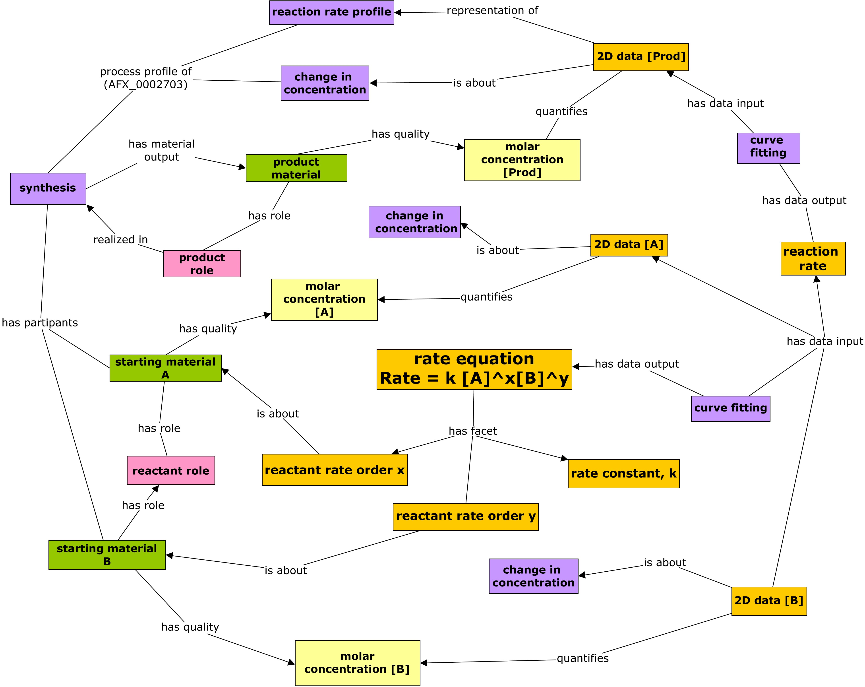
“Pressure Test”: Does Ontology Support Reaction Kinetics?
Modeling of a reaction that has two input materials A and B. The reaction rate kinetics formula is then:
Reaction Rate = k [A]^{x}[B]^{y}
The values including A molar concentration [A], B molar concentration [B], and molar concentration of the output product will be measured
Rate equation
Rate = k[A]^{x}[B]^{y}

Slide 19
Summary & Discussion
Summary:
A thorough survey on process chemistry ontology
A new OPC proposed
OPC development strategy, method, top-level design, and design patterns
OPC maintains its interoperability with Allotrope Foundation ontologies
OPC development just began
Discussion:
OPC could be developed as a standalone ontology and/or become part of Allotrope Foundation Ontologies.
Incorporation into AFO subject to governance and acquiring permission sources used in OPC ontology
Are others interested in participating?
The University of Michigan acknowledges financial support from Merck for this collaboration.

